Slide 1
NYC Crime Analysis
Meixuan Chen, Zhenghan He,
Xinchao Min, Jiaqi Li, Shuyi Lu

Slide 2
CONTENT
Introduction
01
Method
02
Result
03
Summary
04

Slide 3
01
Introduction
PART ONE

Slide 4

Background:
NYC: “City of Crime”
prosperity and sin coexist
Our goal:
To do analysis based on crime data, finding some correlation in crime factors
To make some prediction, which can help improve efficiency for police officer

Slide 5
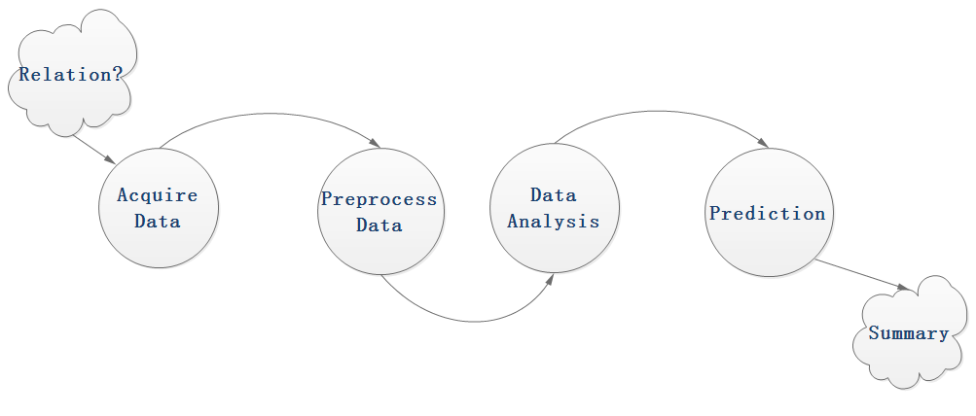
Our Work
Grab data from sources
Clean data
Special case (default)
Data visualization
Clustering
Modeling

Slide 6
Dataset
NYPD Complaint Data
Contains information about types of offence, time of occurrence, specific location and borough
6.04 Millions Rows, 35 Columns
About 1.9 GB, in CSV format

Slide 7
Cleaning Dataset
Removed columns with significant number of NaN
Removed erroneous data (e.g. year = 1015)
Kept entries with 2005 < year < 2018
Changed the column name to descriptive word (e.g. ADDR_PCT_CD -> Neighborhood)

Slide 8
02
Methods
PART TWO

Slide 9
Frameworks we used
SparkML
PySpark
Framework
Sklearn
Matplotlib
Seaborn

Slide 10
03
Data Exploration
PART THREE

Slide 11
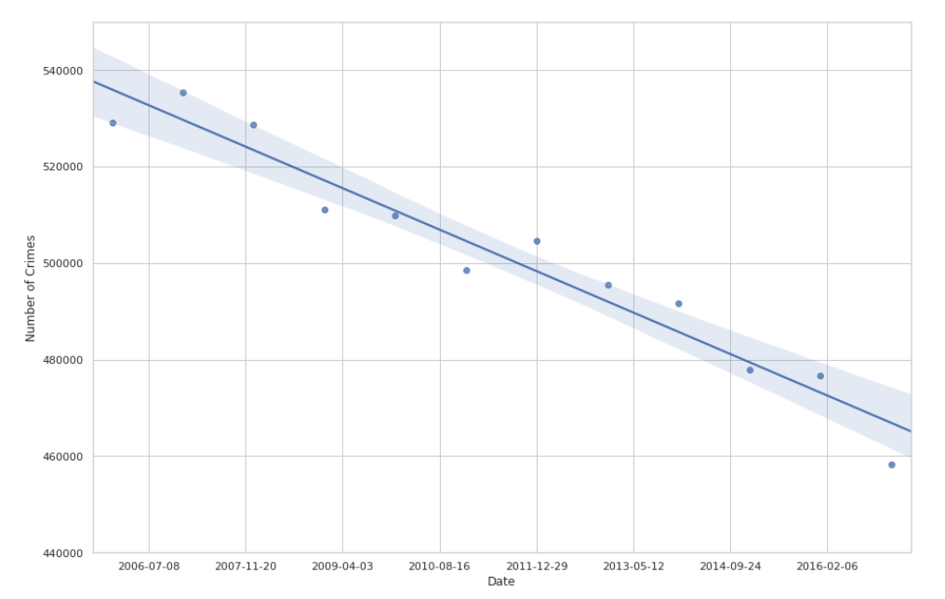
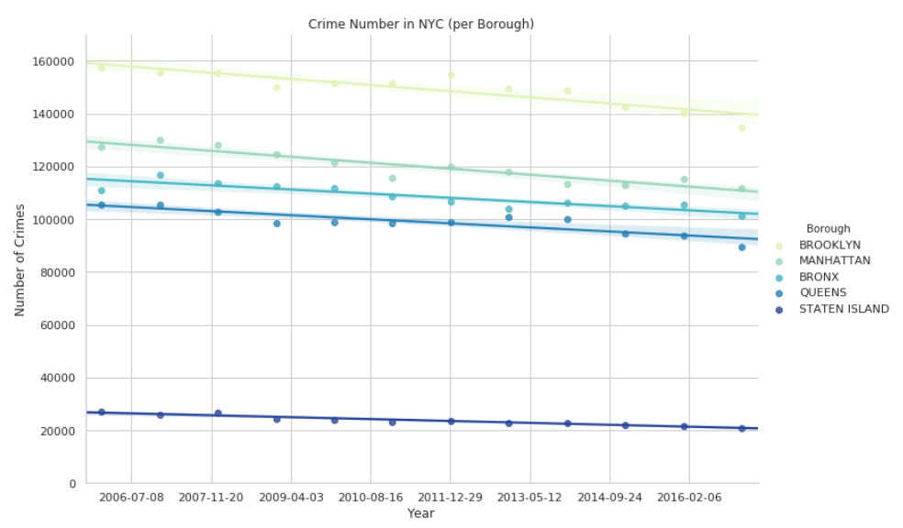
Number of reported crimes declined every year on the city and borough level

Slide 12
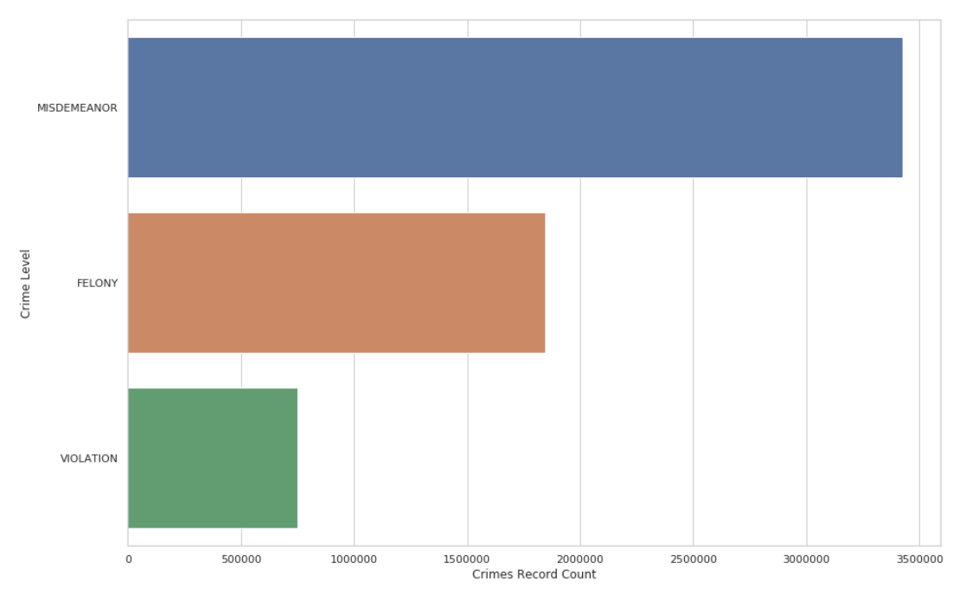
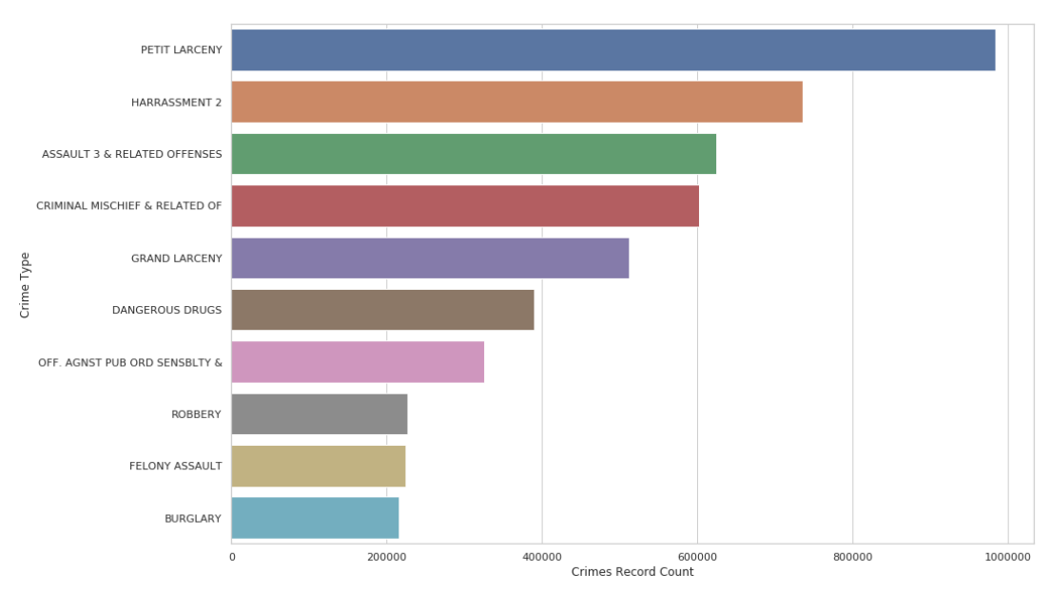

Distribution of crime levels
and crime types

Slide 13
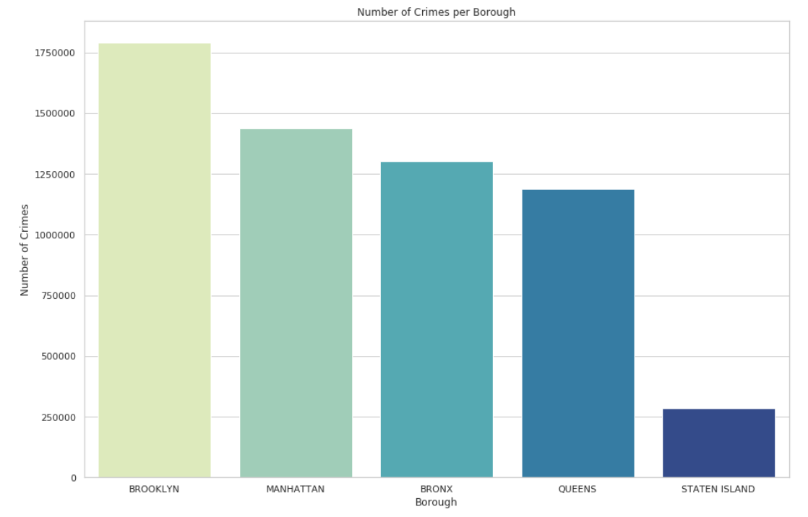
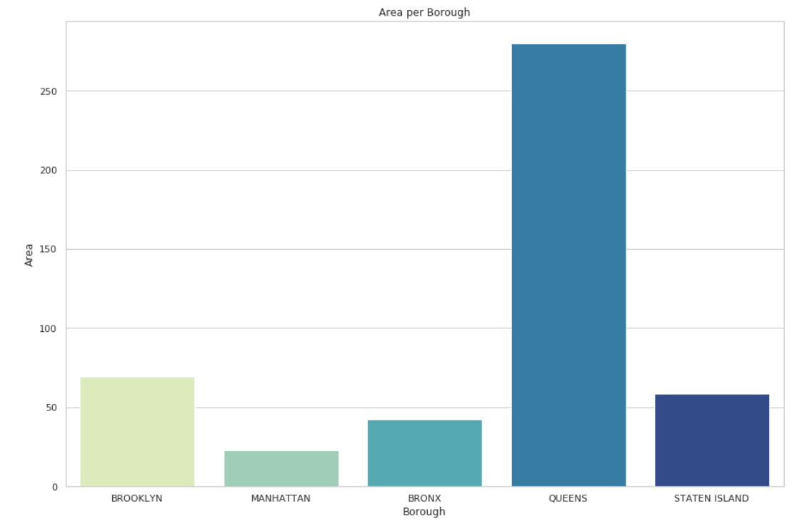
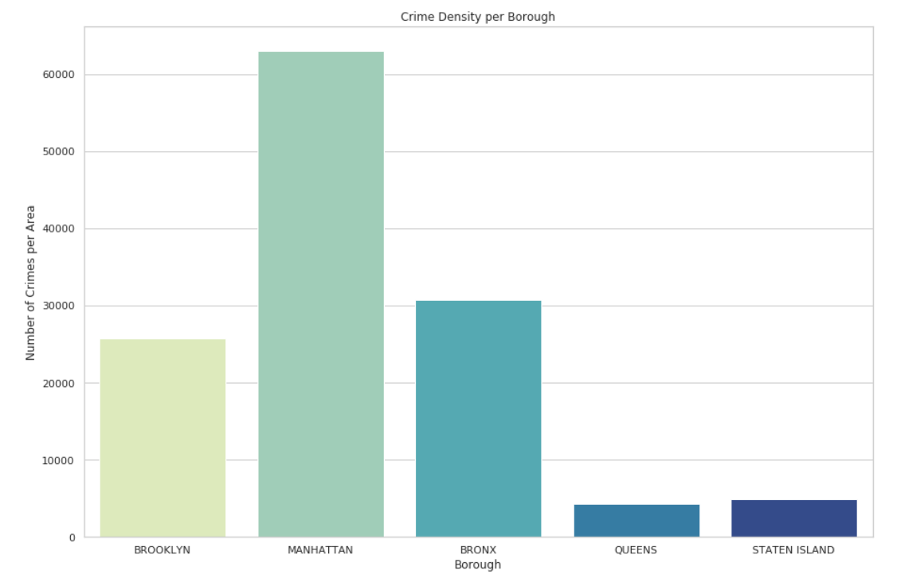
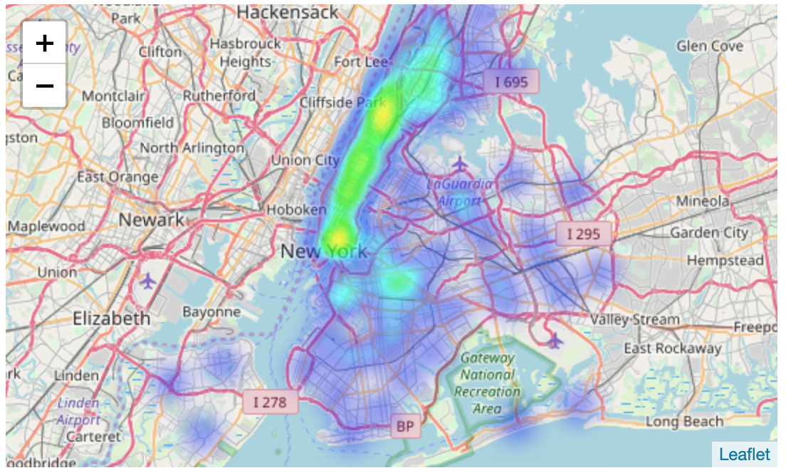
Crime Density of Boroughs

Slide 14
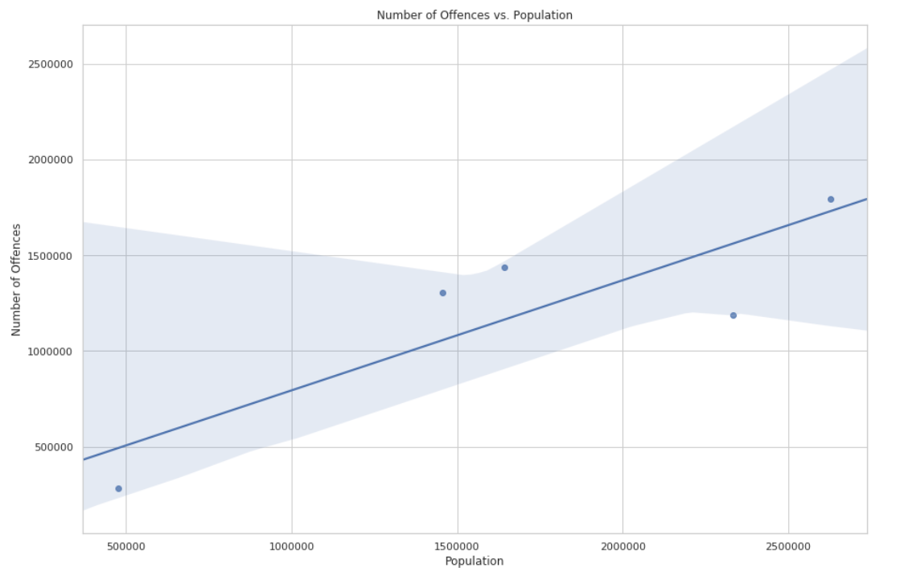
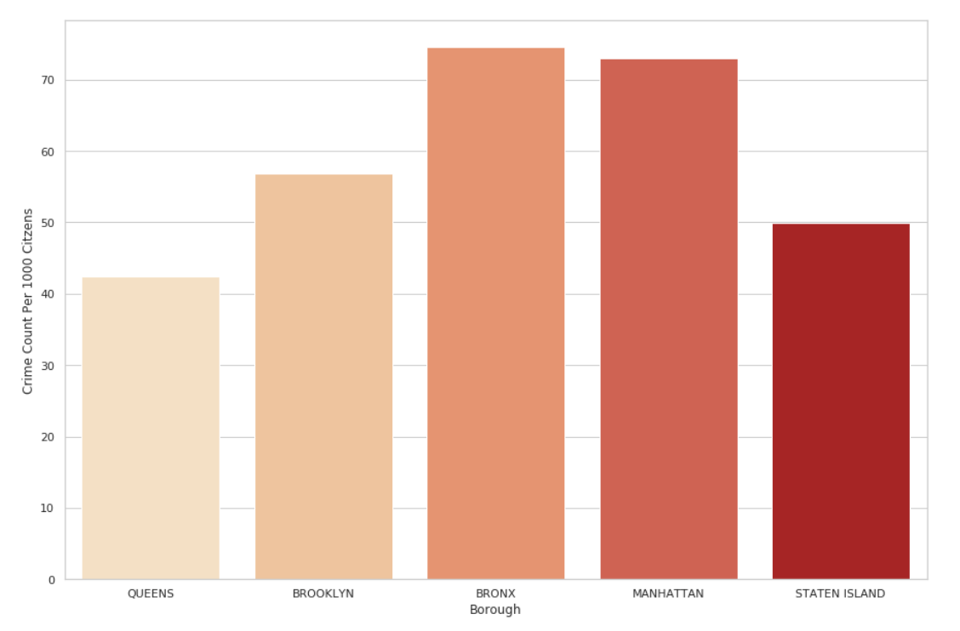
Impacts of population
Points are the population data for boroughs
Crime Rate Per 1000 Citizens Per Year

Slide 15
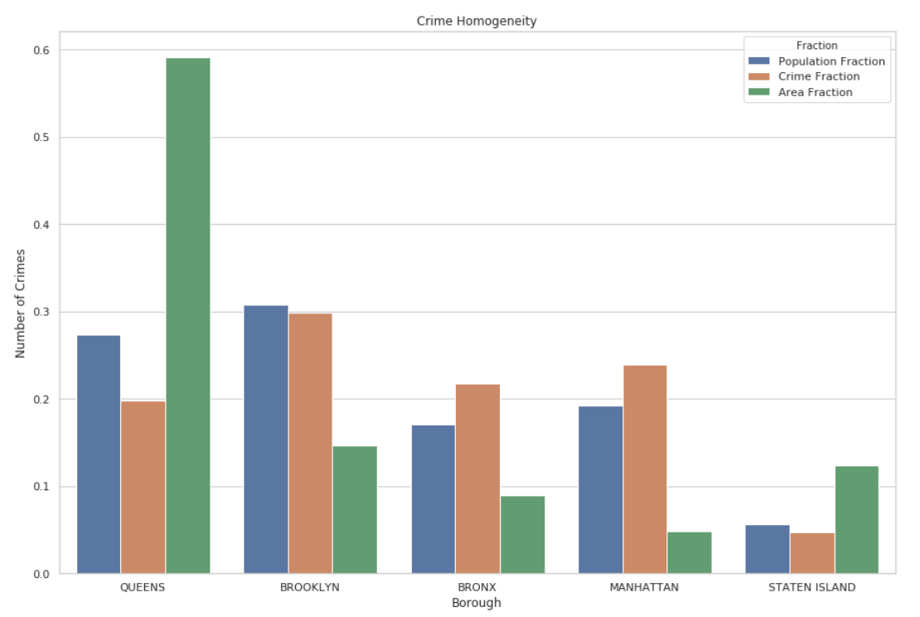
Homogeneity

Slide 16
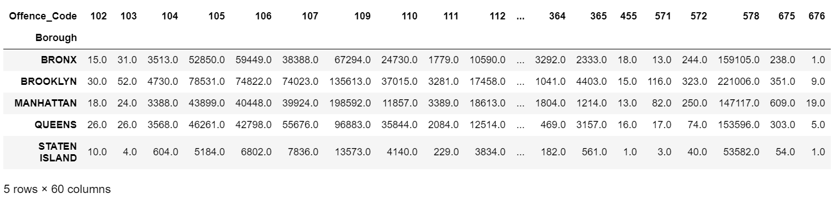
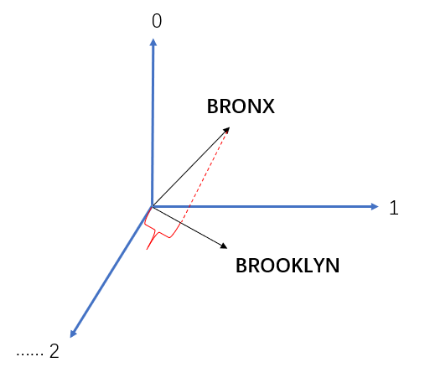
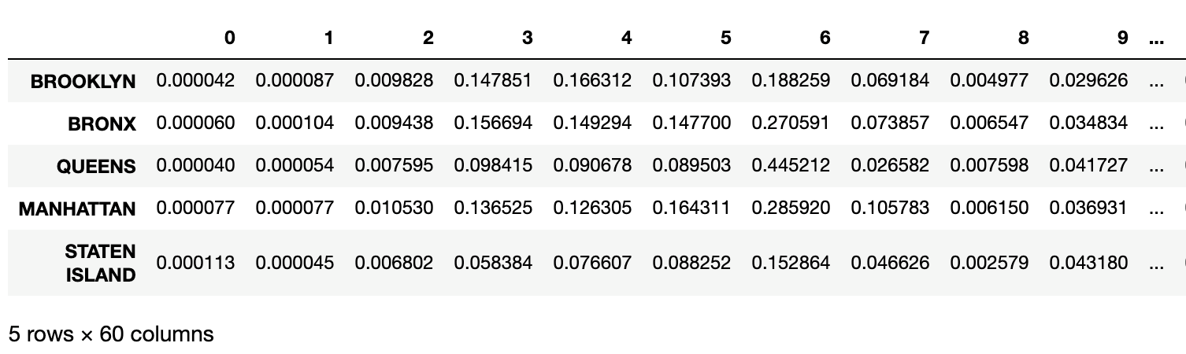
Similarity of Boroughs calculated
by crime patterns

Slide 17
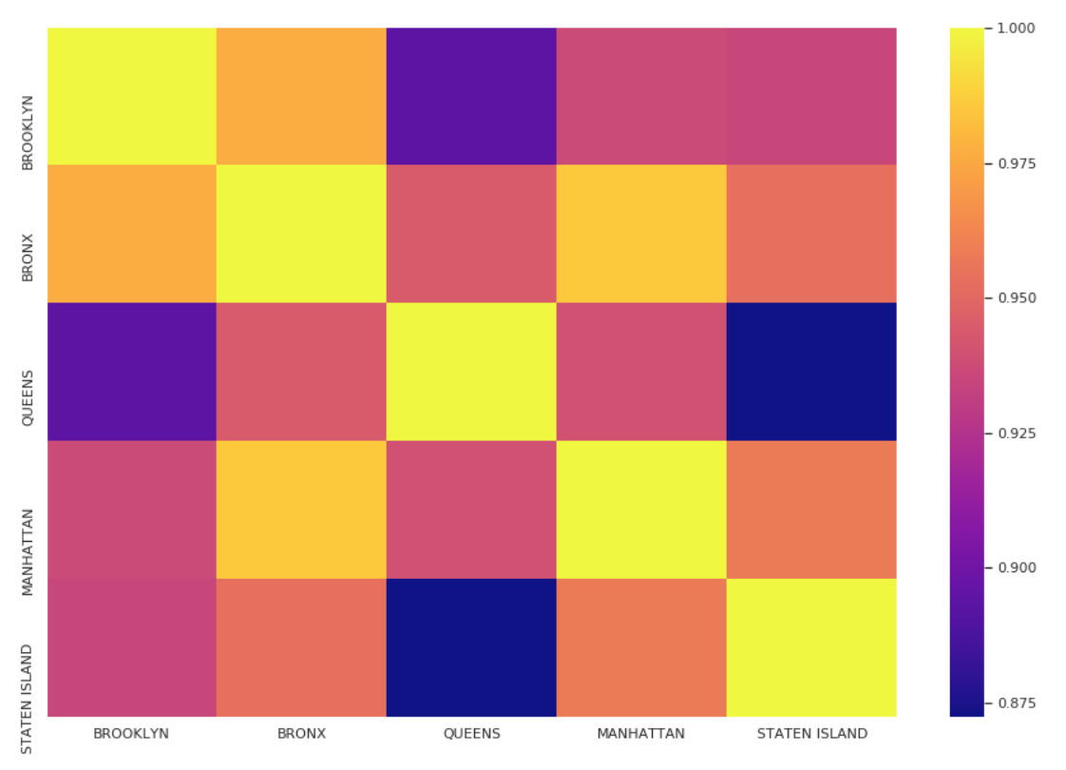
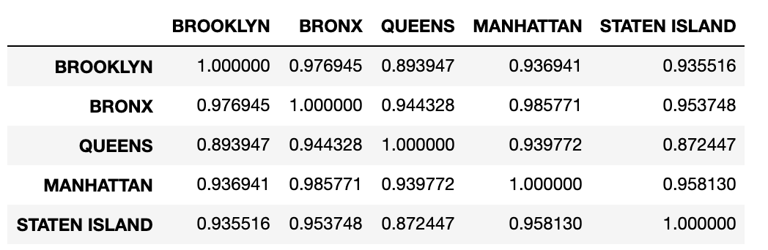
Similarity of Boroughs calculated
by crime patterns

Slide 18
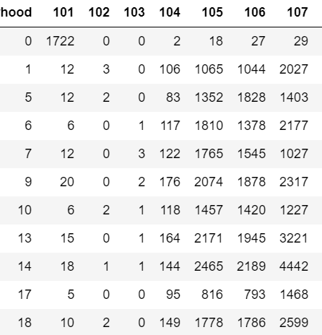
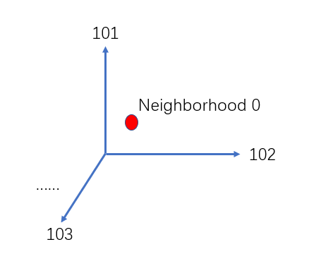
K-Means Cluster
……...
……...

Slide 19
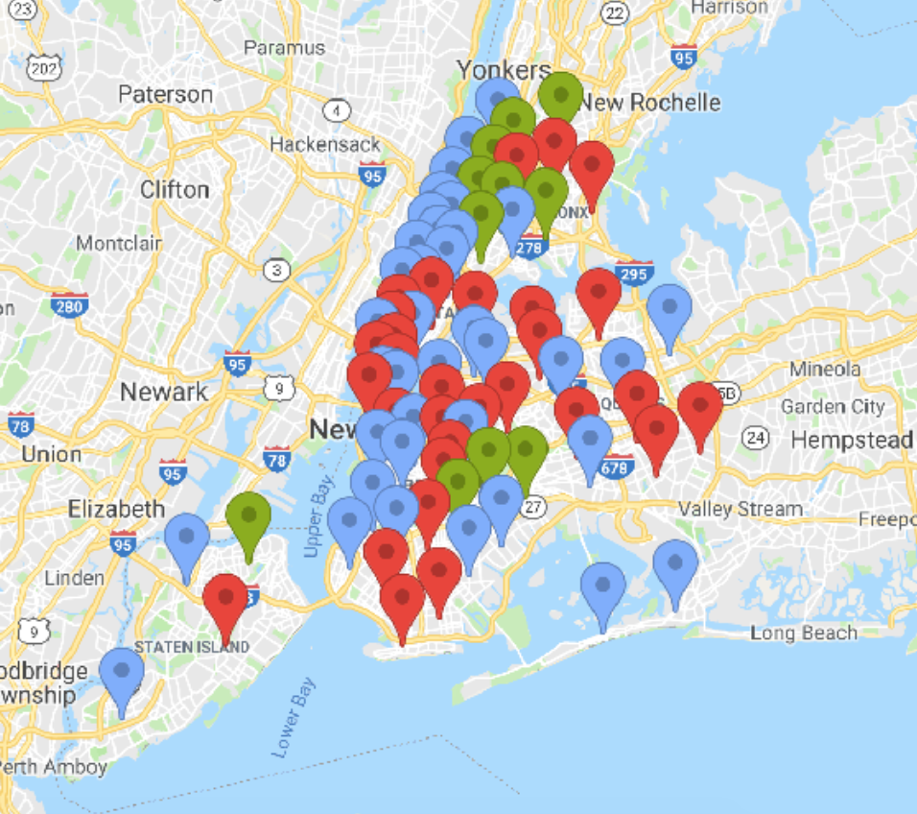
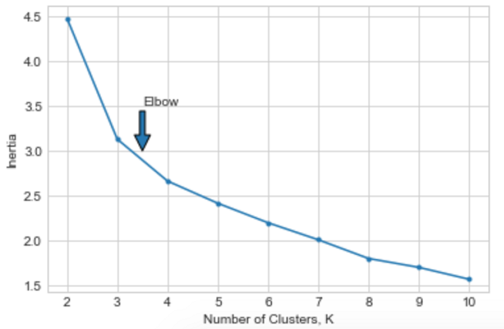
Classification of high-dimensional data
neighborhood is classified into 3 different types based on its Offence_Code and the corresponding number of offences
K-Means Cluster
K = 3

Slide 20
Predict Offense Level
Method: Supervised Method
-KNN
-Random Forest
Attributes:
day_of_week, Latitude, Longitude, Neighborhood, borough

Slide 21
Predict Offense Level
Data preprocessing
-One-hot encoding on day_of_week, Neighborhood, borough
-Normalization
How about missing value in data?
- KNN

Slide 22
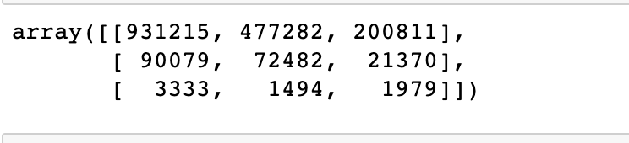
Predict Offense Level
Result:
KNN:
n = 30
accuracy:0.56

Slide 23
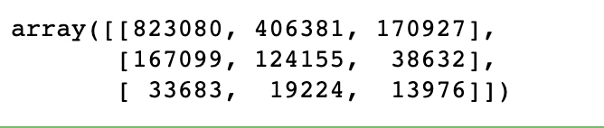
Predict Offsnce Level
Result:
Random Forest:
accuracy:0.53

Slide 24
04
Summary
PART FOUR

Slide 25
Results
Number of offenses decreases every year on the city level as well as in borough level
Crime rates show huge differences if studied per area or per population of given borough
Neighboring precincts show the similarity of offence type and number of offences

Slide 26
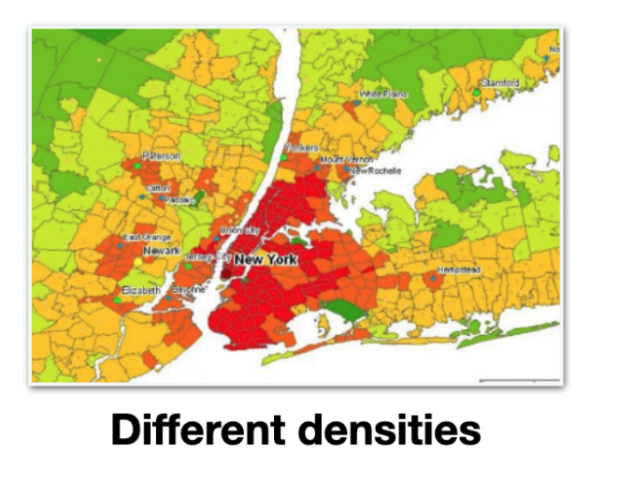
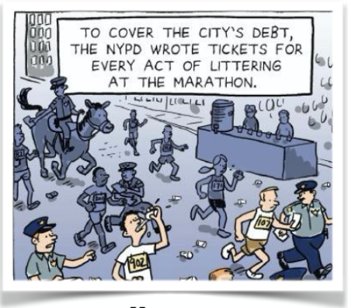
Limitation
No information about police resources deployed in each borough
The population data is based on borough level but it varies among precincts
It is not reliable to predict crime solely based on time and location

Slide 27
Future Work
Study the relation of the housing market with the crime rate (NYC Dept. of Finance provides information on property prices and number of sales per year per borough per type of home)
Study the relation of the neighborhood demographics with the crime rate (NYU Furman Center provides a lot of information on neighborhood demographics between 2010 and 2015)

Slide 28
Thank you!

